Slide 1
COMSE 6901 Spring 2022 Hypotheses of Applying Phylogenetic Tree to Reduce Interaction Matrix Parameters in Generalized Lotka-Volterra Model
Haojun Li
hl3509

Slide 2
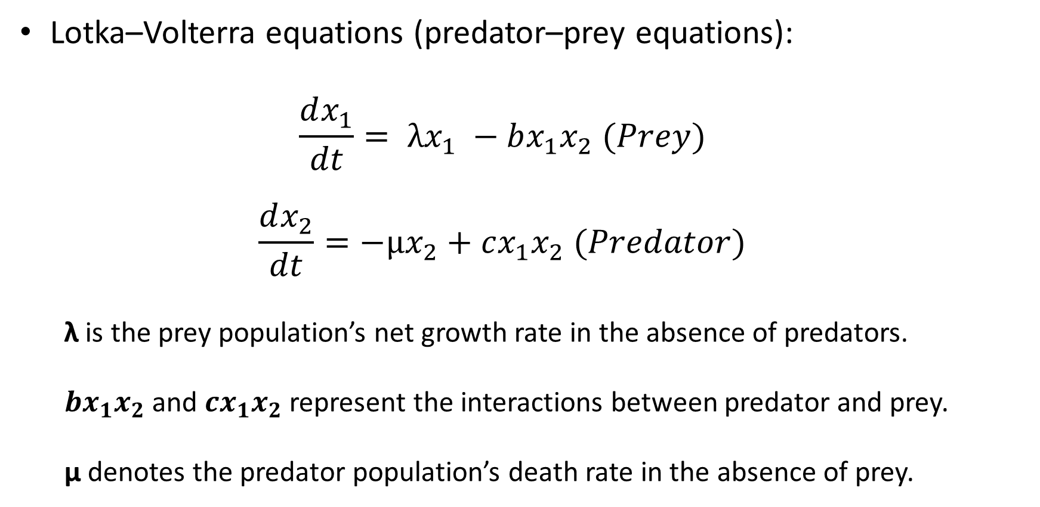
Introduction
Lotka–Volterra equations (predator–prey equations):
$$\frac{dx_{1}}{dt}= λx_{1} −bx_{1}x_{2} (Prey)$$
$$\frac{dx_{2}}{dt}=−μx_{2}+cx_{1}x_{2} (Predator)$$
λ is the prey population’s net growth rate in the absence of predators.
$bx_{1}x_{2}$and $cx_{1}x_{2}$ represent the interactions between predator and prey.
μ denotes the predator population’s death rate in the absence of prey.
Notes:
It is assumed both species move around their habitats at random
The ratio b/c denotes efficiency of converting a unit of prey into a unit of predator

Slide 3
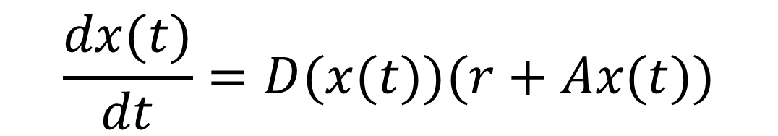
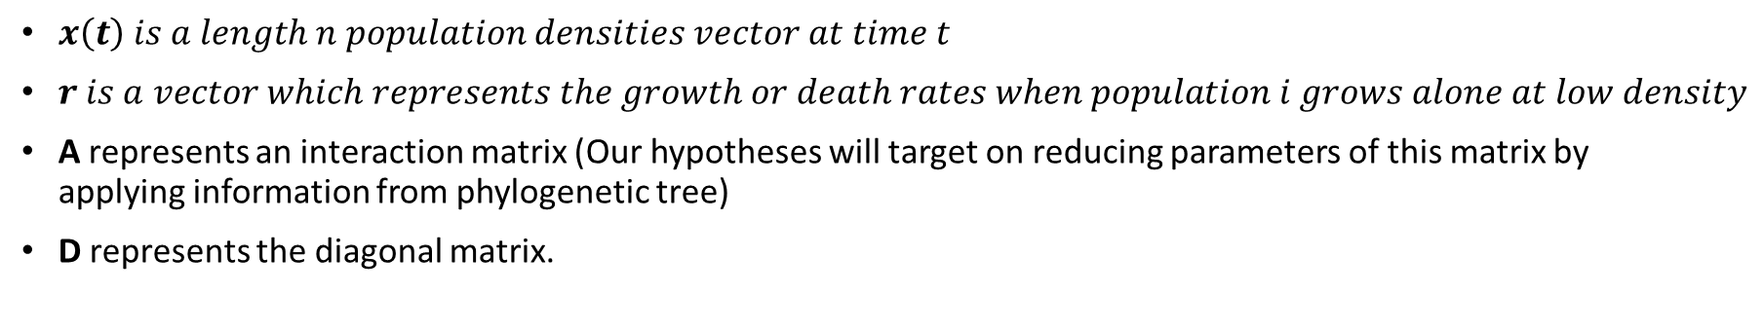
Generalized Lotka-Volterra model
$$\frac{dx(t)}{dt}=D(x(t))(r+Ax(t))$$
$x\left(t\right) is a length n population densities vector at time t$
$r is a vector which represents the growth or death rates when population i grows alone at low density$
A represents an interaction matrix (Our hypotheses will target on reducing parameters of this matrix by applying information from phylogenetic tree)
D represents the diagonal matrix.

Slide 4
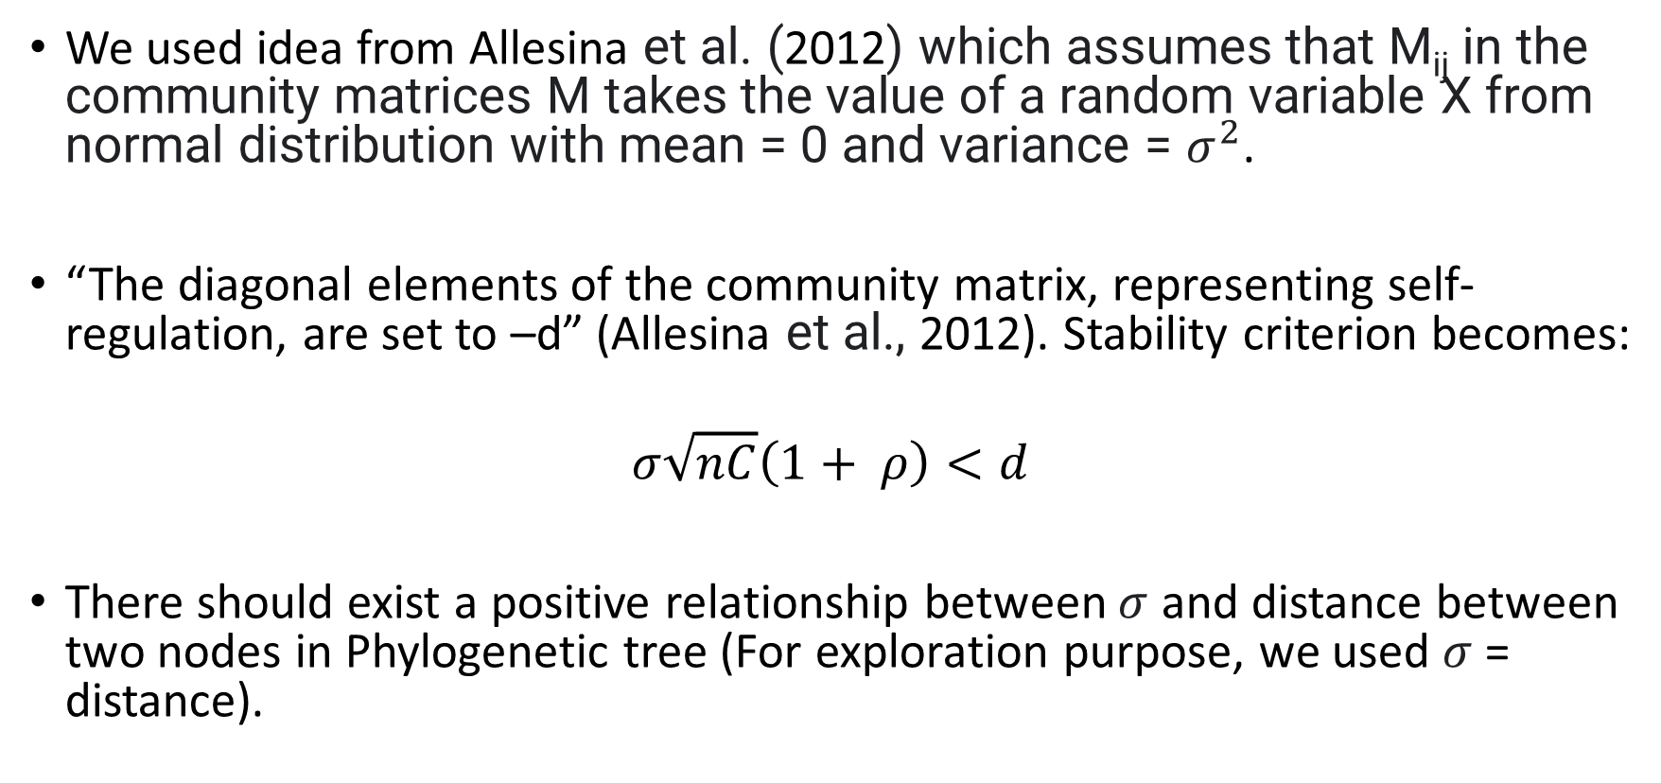
Supports of Hypotheses
We used idea from Allesina et al. (2012) which assumes that M_{ij} in the community matrices M takes the value of a random variable X from normal distribution with mean = 0 and variance = $σ^{2}$.
“The diagonal elements of the community matrix, representing self-regulation, are set to –d” (Allesina et al., 2012). Stability criterion becomes:
$$σ\sqrt{nC}\left(1+ ρ\right)<d$$
There should exist a positive relationship between $σ$ and distance between two nodes in Phylogenetic tree (For exploration purpose, we used $σ$ = distance).
Notes:
M_{ij} describes the effect that species j has on i around a feasible equilibrium point (that is, species have positive densities) of an unspecified dynamical system describing the species’ densities through time.
C: in (0,1]: Sparsity parameter. Higher C = less sparse.
sigma: Variance used to generate multivariate normal covariance matrix.
rho: [-1, 1]. Correlation term of covariance matrix.
Higher rho = mutualism = harder to stabilize.
Lower rho = predator-prey--type relationships = easier to stabilize.

Slide 5
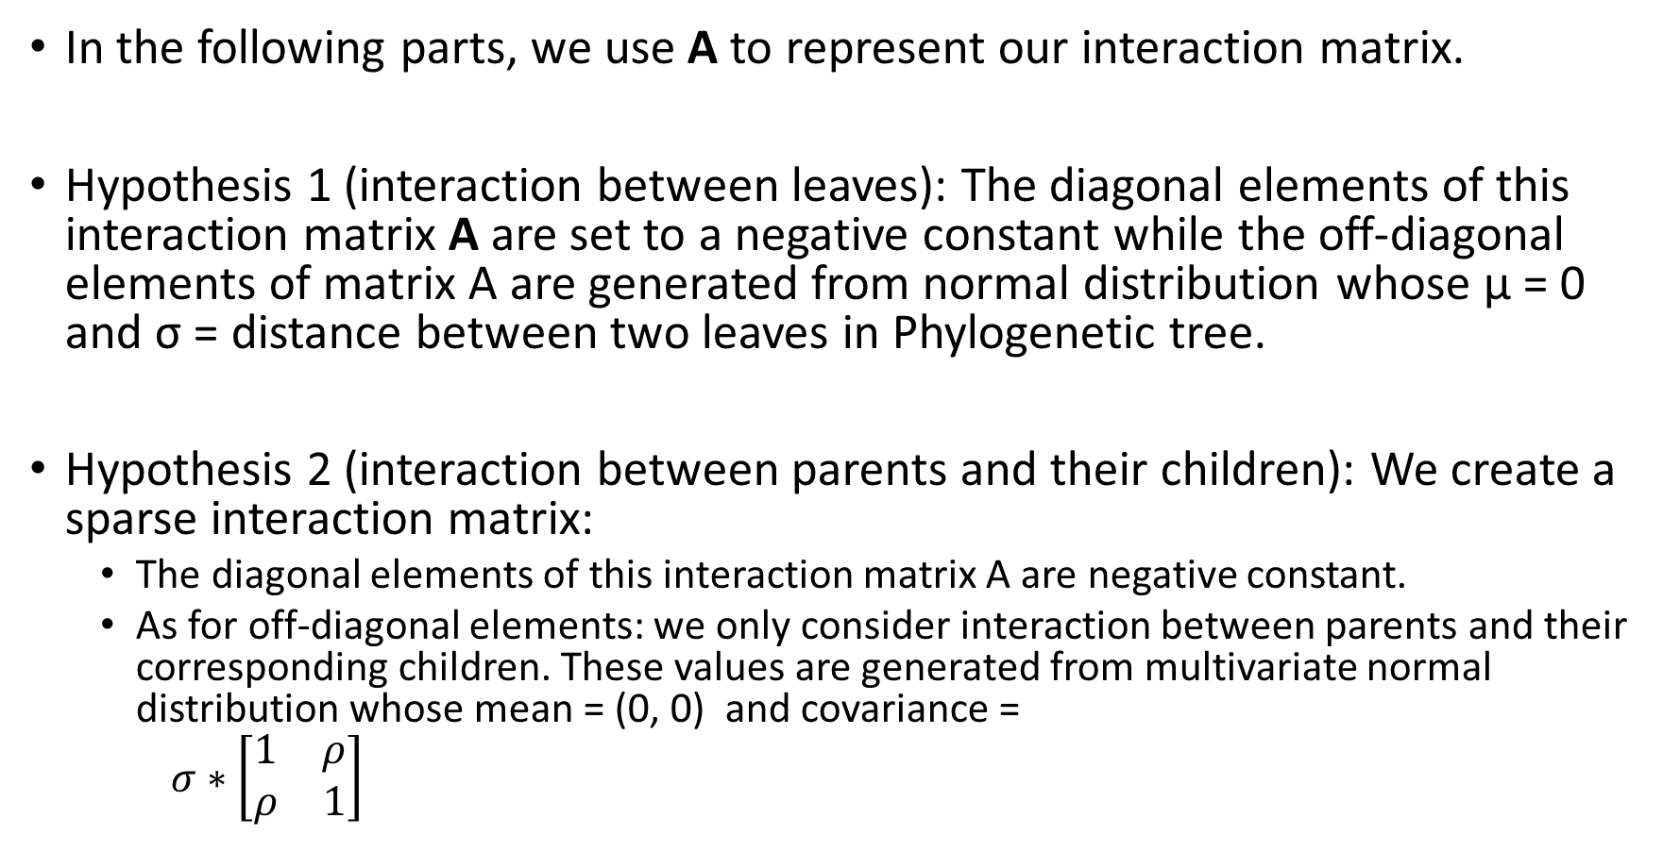
Hypotheses
In the following parts, we use A to represent our interaction matrix.
Hypothesis 1 (interaction between leaves): The diagonal elements of this interaction matrix A are set to a negative constant while the off-diagonal elements of matrix A are generated from normal distribution whose μ = 0 and σ = distance between two leaves in Phylogenetic tree.
Hypothesis 2 (interaction between parents and their children): We create a sparse interaction matrix:
The diagonal elements of this interaction matrix A are negative constant.
As for off-diagonal elements: we only consider interaction between parents and their corresponding children. These values are generated from multivariate normal distribution whose mean = (0, 0) and covariance =
$σ∗\left[\begin{matrix}1 & ρ \\ ρ & 1\end{matrix}\right]$

Slide 6
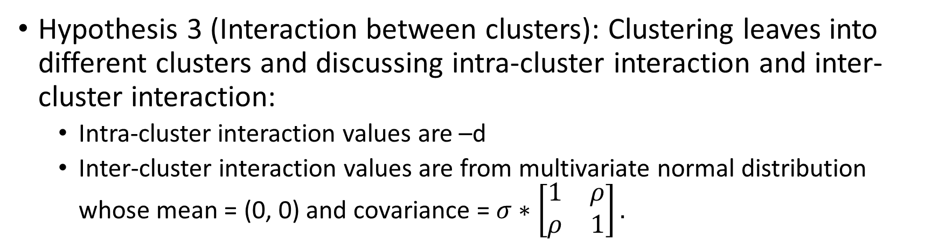
Hypotheses
Hypothesis 3 (Interaction between clusters): Clustering leaves into different clusters and discussing intra-cluster interaction and inter-cluster interaction:
Intra-cluster interaction values are –d
Inter-cluster interaction values are from multivariate normal distribution whose mean = (0, 0) and covariance = $σ∗\left[\begin{matrix}1 & ρ \\ ρ & 1\end{matrix}\right].$
Hypothesis 4 (interaction between leaves): The diagonal elements of interaction matrix A are negative constant while the off-diagonal elements are generated from normal distribution whose μ = 0 and σ = user-specified constant.
Notes:
For Hypothesis 3:
intra-cluster interaction: we have four hypotheses to compute distance:
minimum pairwise distance
maximum pairwise distance
distance between random pair
random constant value
Inter-cluster interaction we have four hypotheses to compute distance:
distance between root nodes
minimum pairwise distance
maximum pairwise distance
distance between random pair

Slide 7
Parameters for demonstration
We mainly follow Allesina et al. (2012); however, we replace some of their specified values with values generated by our hypothesis.
Randomly generated phylogenetic tree and populate it with 250 nodes.
Negative constant for diagonal value = -1 for hypothesis 1, 2, 4.
ρ = -0.5 for hypothesis 2 and 3.

Slide 8
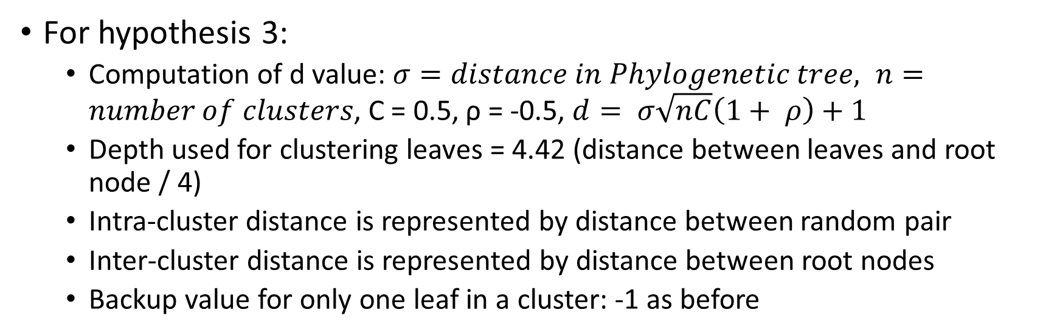
Parameters for demonstration
For hypothesis 3:
Computation of d value: $σ=distance in Phylogenetic tree, n=number of clusters$, C = 0.5, ρ = -0.5, $d= σ\sqrt{nC}\left(1+ ρ\right)+1$
Depth used for clustering leaves = 4.42 (distance between leaves and root node / 4)
Intra-cluster distance is represented by distance between random pair
Inter-cluster distance is represented by distance between root nodes
Backup value for only one leaf in a cluster: -1 as before
For hypothesis 4:
User-defined sigma: 0.5 (used by Allesina et al. in their paper)

Slide 9
Criteria and Basic Sanity Checks
The generated interaction matrix should not break the simulation
There should not be too many species extinction or population explosion
The simulation result should tend to be stable following the time.

Slide 10
Hypothesis 1

Slide 11
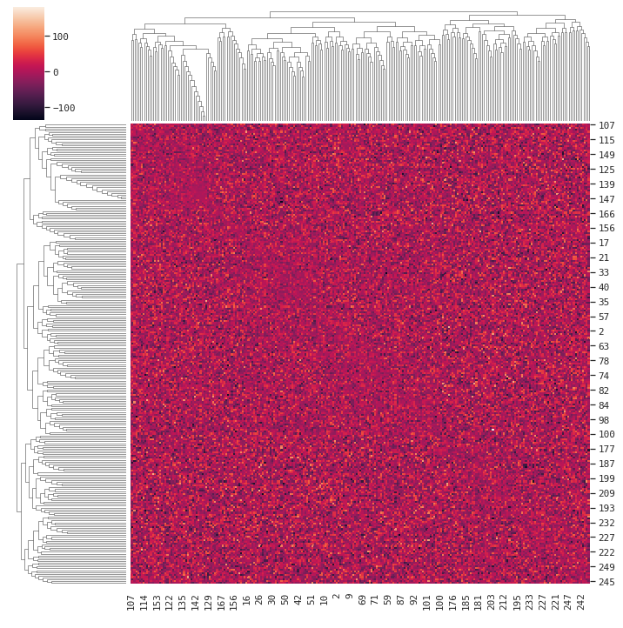
Notes:
Reordered by seaborn, however, the tree and result values are the same
We can notice that the diagonal element remains the same.

Slide 12
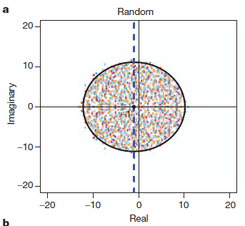
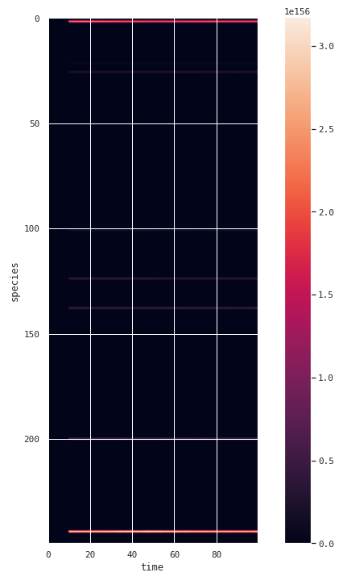
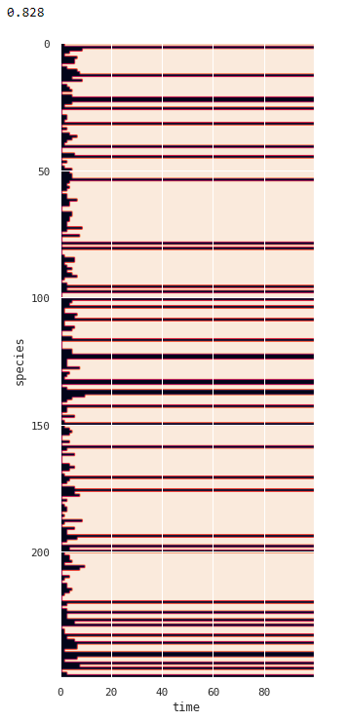
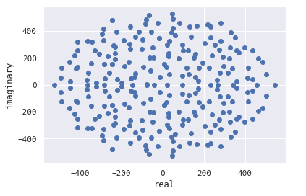
(Allesina et al., 2012)
Notes:
Top-left: eigenvalue plot of 10 community matrices with –d = -1 on the diagonal and off-diagonal elements, following the random prescriptions.
Bottom-left: eigenvalue plot of our generated interaction matrix and it generally matches the pattern in top-left plot. We can generally say that our interaction matrix following the random prescriptions.
For random networks, reducing complexity is the only way to stabilize the system
The middle image displays actions of each species with the change in time in our simulation. Only few of them have relatively strong actions in our simulation after some time while the others have no
or relatively weak actions.
The last image display which species die out in our simulation. 0.828 represents 82.8% of species die out in our simulation. This interaction matrix does not satisfy our sanity check since a lot of species extinct.

Slide 13
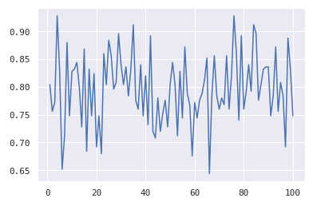
Notes:
Generating interaction matrix for our tree based on hypothesis 1 and performing simulation for 100 times.
This plot displays the extinction rate within each simulation. The extinction rate in all simulation are above 60% and even few of them exceed 90%.
Here are conclusion:
The parameter values we choose are not ideal (As one of our future work, we need to apply optimizer to find more ideal parameters and continue examination).
This hypothesis does not work well.

Slide 14
Hypothesis 2

Slide 15
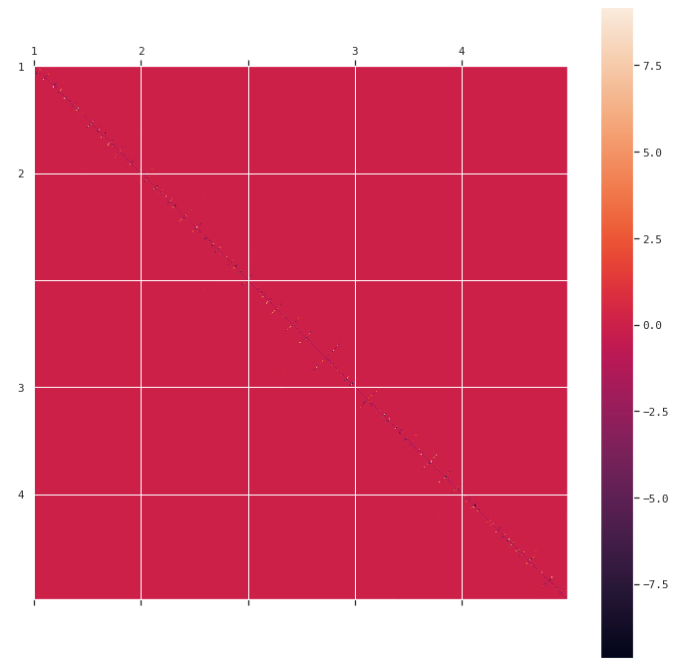
Notes:
This is interaction matrix generated for hypothesis two. We only can observe interaction value near the diagonal, and it is a sparse matrix.
We use this sparsity property as a main way to reduce parameters in the hypothesis.

Slide 16
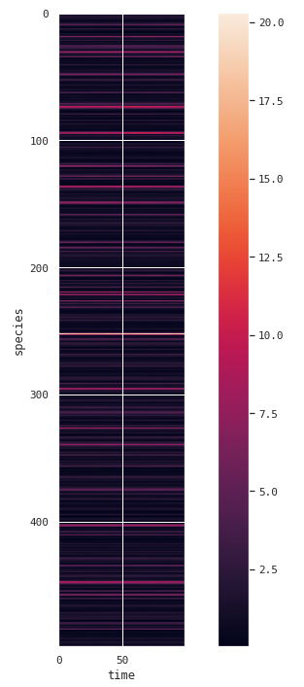
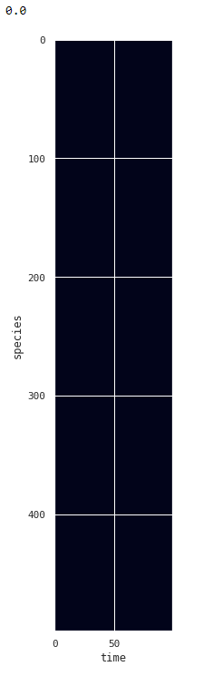
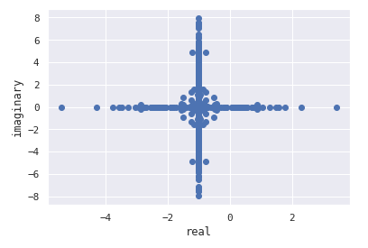
Notes:
The left plot is the eigenvalue plot for hypothesis 2 interaction matrix. We cannot compare this plot with plots provided by Allesina et al. (2012) since they only consider interaction between leaves.
The middle plot displays actions of each species with the change in time in our simulation. Unlike this plot generated for hypothesis 1, each specie’s actions displayed in this plot are more reasonable.
The last plot is show which species extinct in our simulation. Within our simulation time range, there is no extinction which satisfy our expectation and sanity check.

Slide 17
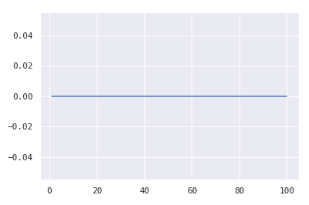
Notes:
This hypothesis is stable, and I used hypothesis 2 to generate interaction matrix and perform simulation 100 times. In each simulation, no species die out.
Also, unlike hypothesis 1 (dense matrix), the speed of finishing 100 matrices generation and simulations under hypothesis 2 is really fast (sparsity property improves the execution speed).
Since this hypothesis pass our basic sanity check, in the future, I will an apply optimizer to find suitable parameters for this hypothesis and even check its robustness.
Instead of using data generated by our code, we will use more realistic data and examine its correctness.

Slide 18
Hypothesis 3

Slide 19
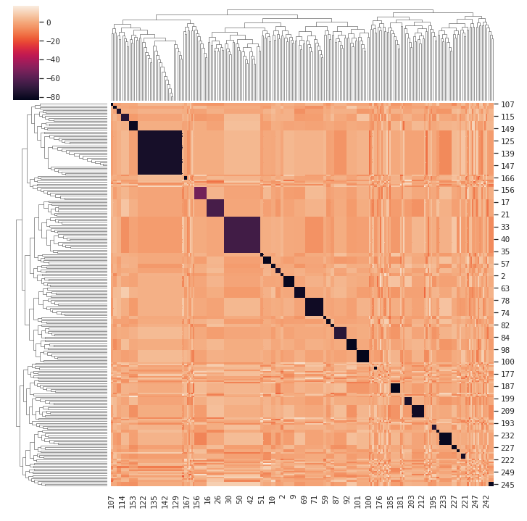
Notes:
We can observe the cluster feature and –d value in the diagonal

Slide 20
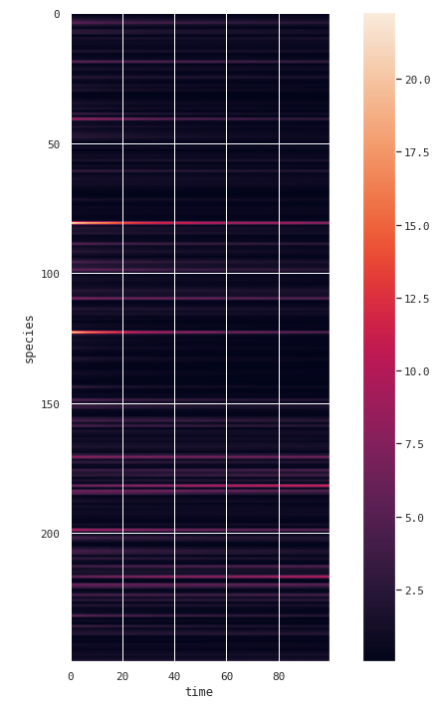
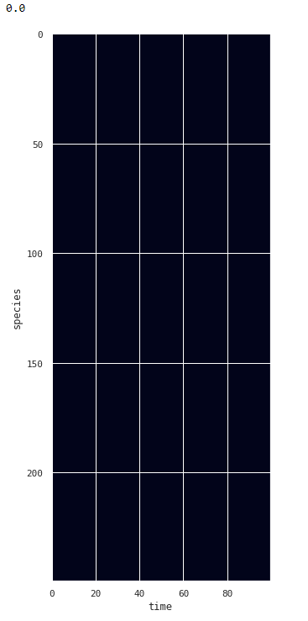
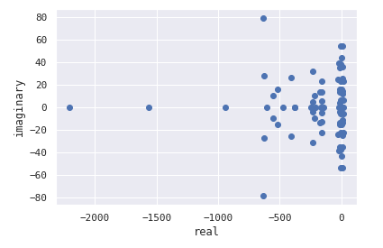
Notes:
The left plot is plot for eigenvalue of interaction matrix. This plot does not look like any plots with random, predator–prey or mixture prescriptions.
The middle is the species action plot: some species have active actions at the beginning of the simulation while some of them have active actions close to the end of this time period.
The last plot displays whether we have species extinction during the simulation. 0.0 means 0% of species die out. This meets our basic sanity checks.

Slide 21
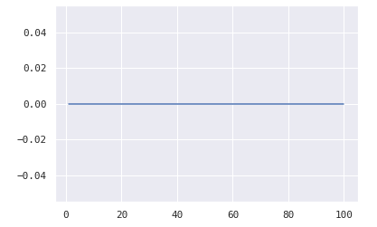
Notes:
100 simulations as before.
In each simulation, no species die out.

Slide 22
Hypothesis 4

Slide 23
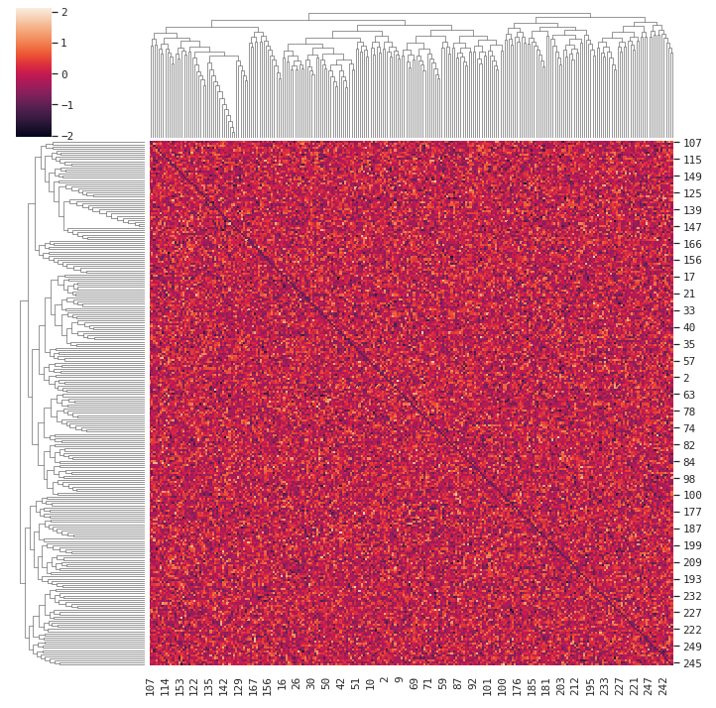
Notes:
This interaction matrix has more narrow range of interaction values compared with previous three.
We also can notice the diagonal elements are equal to -1.

Slide 24
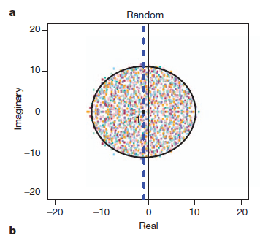
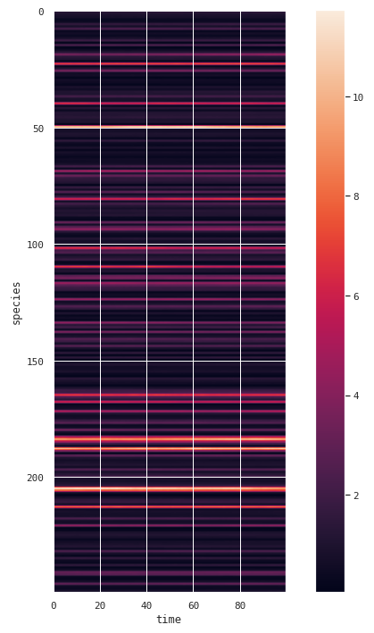
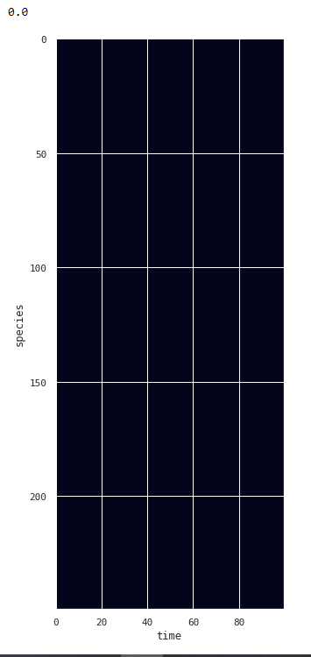
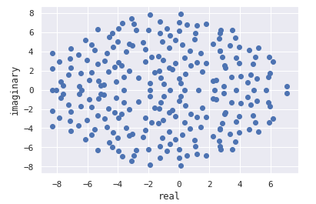
Notes:
The eigenvalue plot for interaction matrix generated for hypothesis 4 matches with eigenvalue plot for random prescriptions.
The middle one is the matrix records species actions over time. The activeness of actions vary from species to species, however, some of species’ actions seem to remain constant through out the time.
Maybe we need to extend time period to these actions will become weak in the future.
Extinction plot. No species extinct during our simulation. Pass the basic sanity check.

Slide 25
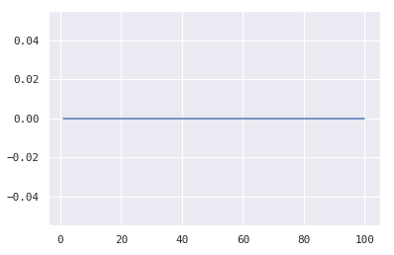
Notes:
No species die out. Good

Slide 26
Conclusion
Comparing to hypotheses 2, 3, and 4, interaction matrix generated from hypothesis 1 will cause a lot extinction. However, we need more experiments with different parameters to make a conclusion.
Hypothesis 2 and 3 have relatively faster speed to generate interaction matrices compared to hypothesis 1 and 4 because of their sparsity properties or clustering properties.
Hypothesis 2,3, and 4 passed our basic sanity check (Appendix will provide more information) and they are good for future real word test.

Slide 27
Future Work
For hypothesis 1, we need to experiment with more combination of parameters in order to decide whether continue with it or discard it.
For hypothesis 2, 3, and 4, we can run them on realistic data and compare results with realistic result.
In order to explore the maximum performance of our hypotheses, an optimizer is needed to help us adjust their parameters.
We need to design an objection function.

Slide 28
References
Allesina, S., & Tang, S. (2012). Stability criteria for complex ecosystems. Nature, 483(7388), 205–208. https://doi.org/10.1038/nature10832
Pchlenski. (n.d.). Pchlenski/misdeed: Microbiome Data Simulator for power analysis. GitHub. Retrieved April 26, 2022, from https://github.com/pchlenski/misdeed

Slide 29
Q & A

Slide 30
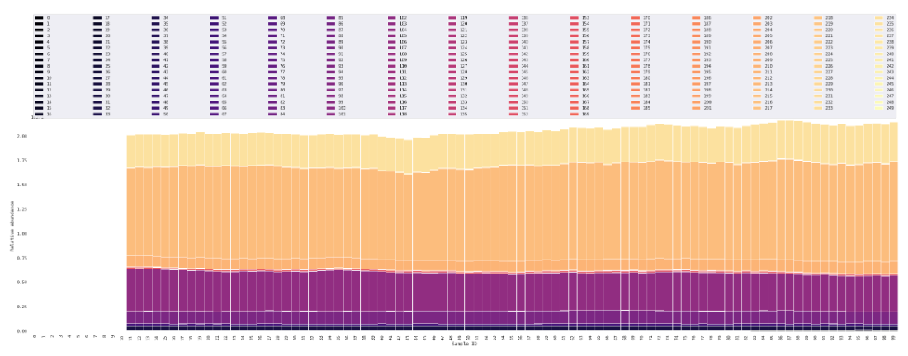
Appendix – hypothesis 1 simulation
Notes:
Notice: This simulation is randomly picked by me from our simulations (to avoid coincidence). This may not be the simulation by using demonstration interaction matrix.

Slide 31
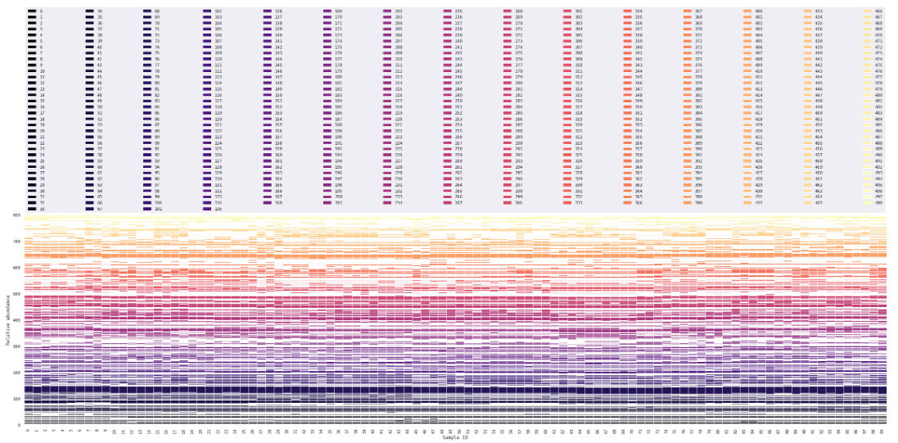
Appendix – hypothesis 2 simulation
Notes:
Notice: This simulation is randomly picked by me from our simulations (to avoid coincidence). This may not be the simulation by using demonstration interaction matrix.

Slide 32
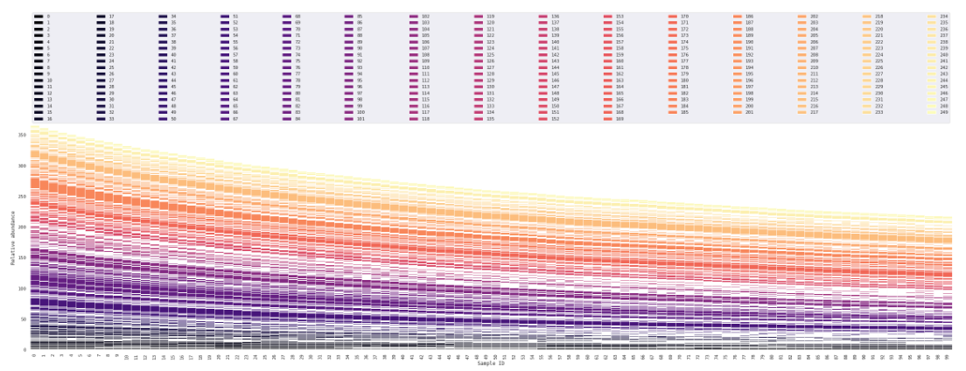
Appendix – hypothesis 3 simulation
Notes:
Notice: This simulation is randomly picked by me from our simulations (to avoid coincidence). This may not be the simulation by using demonstration interaction matrix.

Slide 33
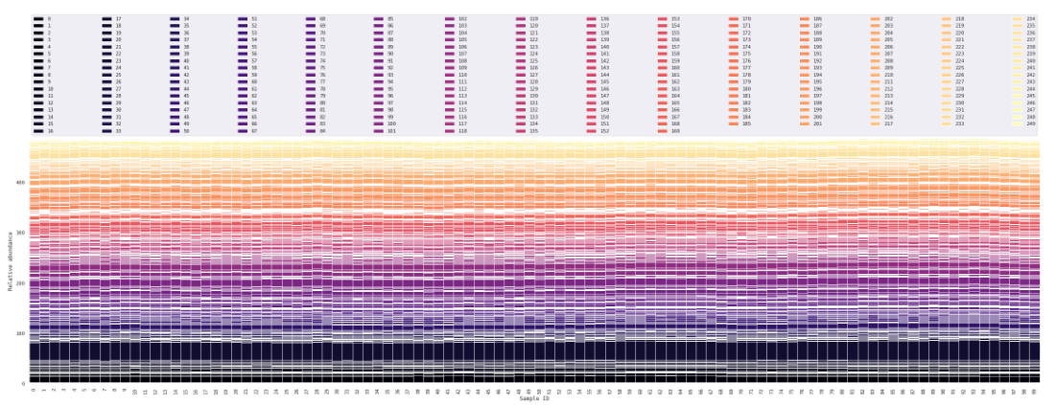
Appendix – hypothesis 4 simulation
Notes:
Notice: This simulation is randomly picked by me from our simulations (to avoid coincidence). This may not be the simulation by using demonstration interaction matrix.

